Slide 1
Congruent triangles (RHS)
Task A: Finding the right angle
1) Using a pair of compasses, find and mark the location of vertex C, which makes the minimum length of BC.
a)
b)
A
c)
B
A
A
B
B
2) Use a protractor to measure angle BCA on each of the diagrams from question 1. What do you notice?
Task B: Justifying congruence by RHS
1) Use RHS to prove the following pairs of triangles are congruent.
a)
C
K
35 cm
12 cm
120 mm
0.35 m
A
B
L
M

Slide 2
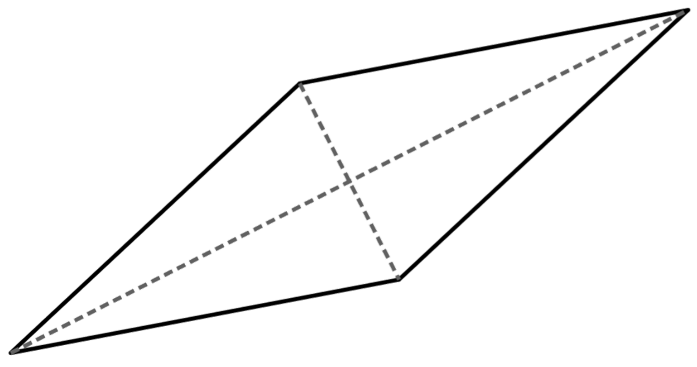
Congruent triangles (RHS)
b)
F
9 cm
O
D
M
37°
12 cm
9 cm
15 cm
15 cm
53°
E
N
2) Triangle TUV is isosceles, where TU = TV. TW is perpendicular to UV.
Prove triangles TUW and TWV are congruent by RHS.
T
U
W
V
3) By using known facts about rhombi and their diagonals prove that triangle AED is congruent to BEC by RHS.
D
A
E
C
B
Mathematics in Education and Industry.
v2.3

